Slide 1
UNIT-III
Bottom-Up Parsing
Compiler Design- Unit-3
Notes:
‹#›

Slide 2
Contents
Bottom up Parsing
Reductions
Handle Pruning
Shift Reduce Parsing
Problems related to Shift Reduce Parsing
Conflicts during Shift Reduce Parsing
Operator Precedence Parser
Computation of LEADING
Computation of TRAILING
Problems related to LEADING AND TRAILING
LR Parsers – Why LR Parsers
Items and LR(0) Automation
Closure of Item sets
LR Parsing Algorithm
SLR Grammars
SLR Parsing Tables
Problems related to SLR
Construction of Canonical LR(1) and LALR
Construction of LALR
Problems related to Canonical LR(1) and LALR Parsing Table
Compiler Design- Unit-3
Notes:
‹#›

Slide 3
Bottom-Up Parsing Introduction
Bottom up parsing works in the opposite direction from top down.
A top down parser begins with the start symbol at the top of the parse tree and works downward, driving productions in forward order until it gets to the terminal leaves.
A bottom up parse starts with the string of terminals itself and builds from the leaves upward, working backwards to the start symbol by applying the productions in reverse.
Along the way, a bottom up parser searches for substrings of the working string that match the right side of some production. When it finds such a substring, it reduces it, i.e., substitutes the left side non-terminal for the matching right side.
The goal is to reduce all the way up to the start symbol and report a successful parse.

Slide 4
Contd…
A bottom-up parse corresponds to the construction of a parse tree for an input string beginning at the leaves (the bottom) and working up towards the root (the top).
It is the process of "reducing" a Input string w to the start symbol of the grammar.
At each reduction step, a specific substring matching the body of a production is replaced by the non terminal at the head of that production
A reduction is the reverse of a step in a derivation, therefore bottom up parser is rightmost derivation in reverse.
The key decisions during bottom-up parsing are about when to reduce and about what production to apply, as the parser proceeds.

Slide 5
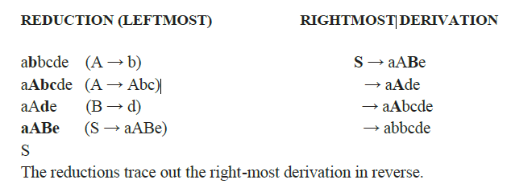
Example for reduction
Example:
Consider the grammar:
S → aABe
A → Abc | b
B → d
The sentence/Input string(w) to be recognized is abbcde.

Slide 6
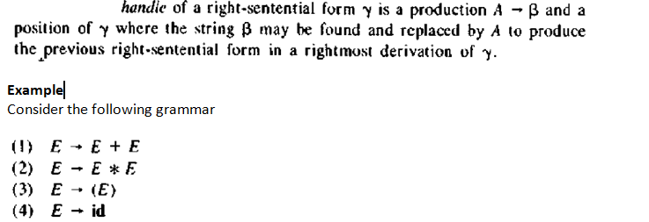
Handle
A "handle" is a substring that matches the right side of a production, and whose reduction to a non terminal in the left side represents previous step in a rightmost derivation in reverse.

Slide 7
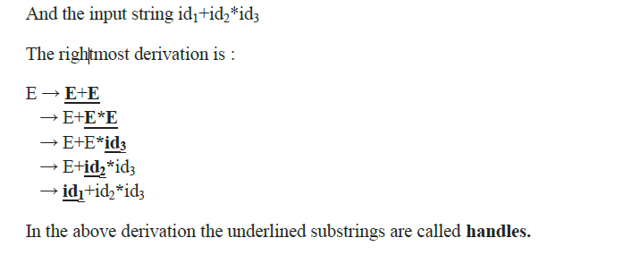
Contd…

Slide 8
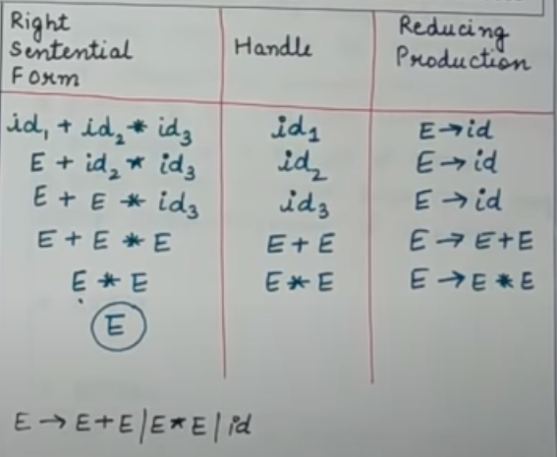
Contd…

Slide 9
Handle Pruning
A Handle is a substring that matches the body of a production.
Handle reduction is a step in the reverse of rightmost derivation.
A rightmost derivation in reverse can be obtained by handle pruning.
The implementation of handle pruning involves the following data-structures:-
a stack - to hold the grammar symbols;
an input buffer that contains the remaining input and a table to decide handles.

Slide 10
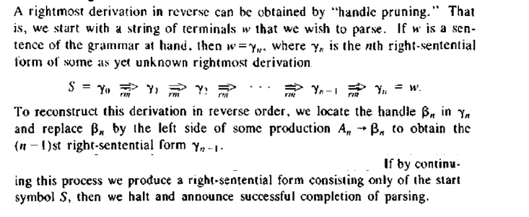
Contd…

Slide 11
Shift-Reduce Parsing
Shift-reduce parsing is a form of bottom-up parsing in which a stack holds grammar symbols and an input buffer holds the rest of the string to be parsed.
Initially, the stack is empty, and the string w is on the input, as follows:
Stack Input Buffer
$ w$
During a left-to-right scan of the input string, the parser shifts zero or more input symbols onto the stack, until the handle appears on top of the stack.
It then reduces by left side of the appropriate production.
The parser repeats this cycle until it has detected an error or until the stack contains the start symbol and the input is empty:
Stack Input Buffer
$S $
Upon entering this configuration, the parser halts and announces successful completion of parsing.

Slide 12

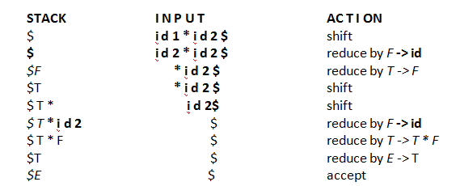
Example
Consider the following grammar and the Input string w= i d 1 * i d 2 $.
Shift reduce parsing for w= i d 1 * i d 2 $.

Slide 13
Contd…
The primary operations are shift and reduce
There are actually four possible actions a shift-reduce parser can make: (1) shift, (2) reduce, (3) accept, and (4) error.
Shift. Shift the next input symbol onto the top of the stack.
Reduce. If the handle appears on top of the stack then, its reduction by using appropriate production rule is done i.e. RHS of production rule is popped out of stack and LHS of production rule is pushed onto the stack.
Accept. Announce successful completion of parsing.
Error. Discover a syntax error and call an error recovery routine.

Slide 14
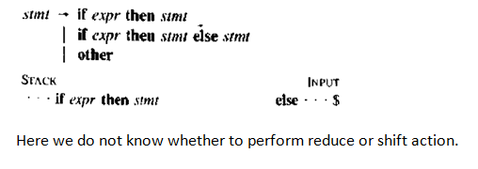
Conflicts During Shift-Reduce Parsing
A shift-reduce parser for a grammar can reach a configuration in which the parser
cannot decide whether to shift or to reduce (a shift/reduce conflict)
cannot decide which of several reductions to make (a reduce/reduce conflict). Reduce-reduce conflicts are rare and usually indicate a problem in the grammar definition.
Example for shift/reduce conflict

Slide 15
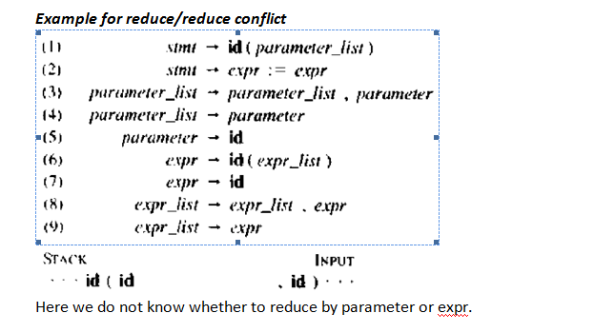
Example for reduce/reduce conflict

Slide 16
Bottom-Up Parsing
A bottom-up parser creates the parse tree of the given input starting from leaves towards the root.
A bottom-up parser tries to find the right-most derivation of the given input in the reverse order.
S ⇒ ... ⇒ ω (the right-most derivation of ω)
← (the bottom-up parser finds the right-most derivation in the reverse order)
Compiler Design- Unit-3
Notes:
lec04-bottomupparser
*
‹#›

Slide 17
Operator-Precedence Parser
Operator grammar
small, but an important class of grammars
we may have an efficient operator precedence parser (a shift-reduce parser) for an operator grammar.
In an operator grammar, no production rule can have:
ε at the right side
two adjacent non-terminals at the right side.
Ex:
E→AB E→EOE E→E+E |
A→a E→id E*E |
B→b O→+|*|/ E/E | id
not operator grammar not operator grammar operator grammar
Compiler Design- Unit-3

Slide 18
Precedence Relations
In operator-precedence parsing, we define three disjoint precedence relations between certain pairs of terminals.
a <. b b has higher precedence than a
a =· b b has same precedence as a
a .> b b has lower precedence than a
The determination of correct precedence relations between terminals are based on the traditional notions of associativity and precedence of operators. (Unary minus causes a problem).
Compiler Design- Unit-3

Slide 19
Using Operator-Precedence Relations
The intention of the precedence relations is to find the handle of a right-sentential form,
<. with marking the left end,
=· appearing in the interior of the handle, and
.> marking the right hand.
In our input string $a₁a₂...a_{n}$, we insert the precedence relation between the pairs of terminals (the precedence relation holds between the terminals in that pair).
Compiler Design- Unit-3

Slide 20
Using Operator -Precedence Relations
E → E+E | E-E | E*E | E/E | E^E | (E) | -E | id
The partial operator-precedence
table for this grammar
Then the input string id+id*id with the precedence relations inserted will be:
$ <. id .> + <. id .> * <. id .> $
 | id | + | * | $
id |  | .> | .> | .>
+ | <. | .> | <. | .>
* | <. | .> | .> | .>
$ | <. | <. | <.
Compiler Design- Unit-3

Slide 21
To Find The Handles
Scan the string from left end until the first .> is encountered.
Then scan backwards (to the left) over any =· until a <. is encountered.
The handle contains everything to left of the first .> and to the right of the <. is encountered.
$ <. id .> + <. id .> * <. id .> $ E → id $ id + id * id $
$ <. + <. id .> * <. id .> $ E → id $ E + id * id $
$ <. + <. * <. id .> $ E → id $ E + E * id $
$ <. + <. * .> $ E → E*E $ E + E * .E $
$ <. + .> $ E → E+E $ E + E $
$ $ $ E $
Compiler Design- Unit-3

Slide 22
Operator-Precedence Parsing Algorithm
The input string is w$, the initial stack is $ and a table holds precedence relations between certain terminals
Algorithm:
set p to point to the first symbol of w$ ;
repeat forever
if ( $ is on top of the stack and p points to $ ) then return
else {
let a be the topmost terminal symbol on the stack and let b be the symbol pointed to by p;
if ( a <. b or a =· b ) then { /* SHIFT */
push b onto the stack;
advance p to the next input symbol;
}
else if ( a .> b ) then /* REDUCE */
repeat pop stack
until ( the top of stack terminal is related by <. to the terminal most recently popped );
else error();
}
Compiler Design- Unit-3

Slide 23
Operator-Precedence Parsing Algorithm -- Example
stack input action
$ id+id*id$ $ <. id shift
$id +id*id$ id .> + reduce E → id
$ +id*id$ shift
$+ id*id$ shift
$+id *id$ id .> * reduce E → id
$+ *id$ shift
$+* id$ shift
$+*id $ id .> $ reduce E → id
$+* $ * .> $ reduce E → E*E
$+ $ + .> $ reduce E → E+E
$ $ accept
Compiler Design- Unit-3

Slide 24
How to Create Operator-Precedence Relations
We use associativity and precedence relations among operators.
If operator O₁ has higher precedence than operator O₂, 🡺 O₁ .> O₂ and O₂ <. O₁
If operator O₁ and operator O₂ have equal precedence, they are left-associative 🡺 O₁ .> O₂ and O₂ .> O₁ they are right-associative 🡺 O₁ <. O₂ and O₂ <. O₁
For all operators O, O <. id, id .> O, O <. (, (<. O, O .> ), ) .> O, O .> $, and $ <. O
Also, let
(=·) $ <. ( id .> ) ) .> $
( <. ( $ <. id id .> $ ) .> )
( <. id
Compiler Design- Unit-3

Slide 25
Operator-Precedence Relations
 | + | - | * | / | ^ | id | ( | ) | $
+ | .> | .> | <. | <. | <. | <. | <. | .> | .>
- | .> | .> | <. | <. | <. | <. | <. | .> | .>
* | .> | .> | .> | .> | <. | <. | <. | .> | .>
/ | .> | .> | .> | .> | <. | <. | <. | .> | .>
^ | .> | .> | .> | .> | <. | <. | <. | .> | .>
id | .> | .> | .> | .> | .> |  |  | .> | .>
( | <. | <. | <. | <. | <. | <. | <. | =·
) | .> | .> | .> | .> | .> |  |  | .> | .>
$ | <. | <. | <. | <. | <. | <. | <.
Compiler Design- Unit-3

Slide 26
Handling Unary Minus
Operator-Precedence parsing cannot handle the unary minus when we also the binary minus in our grammar.
The best approach to solve this problem, let the lexical analyzer handle this problem.
The lexical analyzer will return two different operators for the unary minus and the binary minus.
The lexical analyzer will need a lookhead to distinguish the binary minus from the unary minus.
Then, we make
O <. unary-minus for any operator
unary-minus .> O if unary-minus has higher precedence than O
unary-minus <. O if unary-minus has lower (or equal) precedence than O
Compiler Design- Unit-3

Slide 27
Precedence Functions
Compilers using operator precedence parsers do not need to store the table of precedence relations.
The table can be encoded by two precedence functions f and g that map terminal symbols to integers.
For symbols a and b.
f(a) < g(b) whenever a <. b
f(a) = g(b) whenever a =· b
f(a) > g(b) whenever a .> b
Compiler Design- Unit-3

Slide 28
Disadvantages of Operator Precedence Parsing
Disadvantages:
It cannot handle the unary minus (the lexical analyzer should handle the unary minus).
Small class of grammars.
Difficult to decide which language is recognized by the grammar.
Advantages:
simple
powerful enough for expressions in programming languages
Compiler Design- Unit-3

Slide 29
Error Recovery in Operator-Precedence Parsing
Error Cases:
No relation holds between the terminal on the top of stack and the next input symbol.
A handle is found (reduction step), but there is no production with this handle as a right side
Error Recovery:
Each empty entry is filled with a pointer to an error routine.
Decides the popped handle “looks like” which right hand side. And tries to recover from that situation.
Compiler Design- Unit-3

Slide 30
Computation of LEADING & TRAILING
Two Methods to determine a precedence relation between a pair of terminals
Based on associativity and precedence relations of operators
Using Operator Precedence Grammar
Implementation of Operator-Precedence Parser:
An operator-precedence parser is a simple shift-reduce parser that is capable of parsing a subset of LR(1) grammars.
The operator-precedence parser can parse all LR(1) grammars where two consecutive non-terminals and epsilon never appear in the right-hand side of any rule.
Compiler Design- Unit-3

Slide 31
Computation of LEADING & TRAILING
Steps involved in Parsing:
1. Ensure the grammar satisfies the pre-requisite.
2. Computation of the function LEADING()
3. Computation of the function TRAILING()
4. Using the computed leading and trailing ,construct the operator Precedence Table
5. Parse the given input string based on the algorithm
6. Compute Precedence Function and graph.
Compiler Design- Unit-3

Slide 32
Computation of LEADING
Leading is defined for every non-terminal. Terminals that can be the first terminal in a string derived from that non-terminal.
Compute LEADING (A)
• LEADING (A) = {a| A → γaδ, where γ is ε or a single non-terminal.}
• Rule 1: a is in LEADING (A) if there is a production of the form A → γaδ, Where γ is ε or a single non-terminal
• Rule 2: a is in LEADING (B) and if there is a production of the form A → Bα, then a is in LEADING (A)
Compiler Design- Unit-3

Slide 33
Computation of TRAILING
Trailing is defined for every non-terminal. • Terminals that can be the last terminal in a string derived from that non-terminal.
Compute TRAILING (A)
• TRAILING (A) = {a| A → γaδ, where δ is ε or a single non-terminal.}
• Rule 1: a is in TRAILING (A) if there is a production of the form A → γaδ, Where δ is ε or a single non-terminal
• Rule 2: a is in TRAILING (B) and if there is a production of the form
A → αB, then a is in TRAILING (A)
Compiler Design- Unit-3

Slide 34
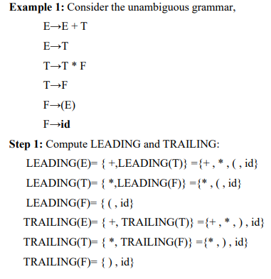
Computation of LEADING & TRAILING--Example
Compiler Design- Unit-3

Slide 35
Algorithm for constructing Precedence Relation Table
Step 2: After computing LEADING and TRAILING, the table is constructed between all the terminals in the grammar including the ‘$’ symbol.
PARSINGTABLE(Grammar G, LEADING(), TRAILING() )
{
For each production A 🡪X1X2X3 ...Xn
for i = 1 to n-1
1. if Xi and Xi+1 are terminals
set Xi =· Xi+1
2. if i ≤ n-2 and Xi and Xi+2 are terminals and Xi+1 is a non-terminal
set Xi =· Xi+2
3. if Xi is a terminal and Xi+1 is a non-terminal then for all ‘a’ in
Leading(Xi+1) set Xi <. a
4. if Xi is a non-terminal and Xi+1 is a terminal then for all ‘a’ in
Trailing(Xi) set a .> Xi+1
}
Compiler Design- Unit-3

Slide 36
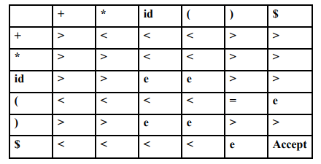
Precedence Relation Table
Compiler Design- Unit-3

Slide 37
Parsing Algorithm
Algorithm:
set p to point to the first symbol of w$ ;
repeat forever
if $ is on top of the stack and p points to $ then return
else begin
let a be the topmost terminal symbol on the stack and let b be the symbol pointed to by p;
if ( a <. b or a =· b ) then
push b onto the stack;
advance p to the next input symbol;
end
else if a .> b then
repeat pop stack
until the top of stack terminal is related by <. to the terminal most recently popped
else error();
end
Compiler Design- Unit-3

Slide 38
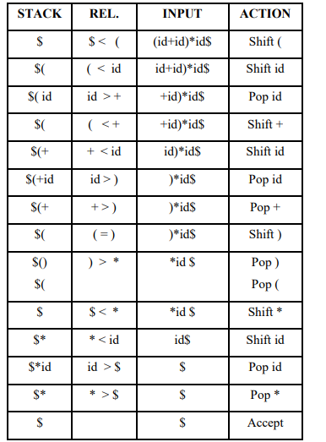
Parse the given input string (id+id)*id$
Step 3
Compiler Design- Unit-3

Slide 39

Precedence Functions
Compilers using operator-precedence parsers need not store the table of precedence relations. In most cases, the table can be encoded by two precedence functions f and g that map terminal symbols to integers. We attempt to select f and g so that, for symbols a and b.
Compiler Design- Unit-3

Slide 40

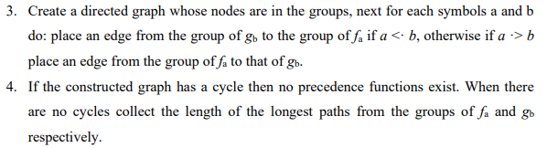
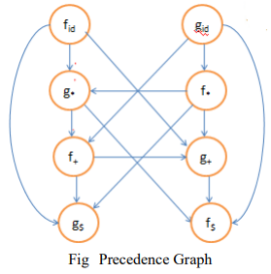


Algorithm for Constructing Precedence Functions
Compiler Design- Unit-3

Slide 41
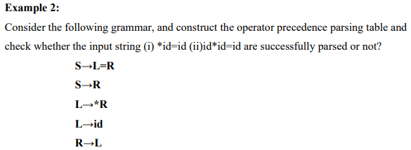
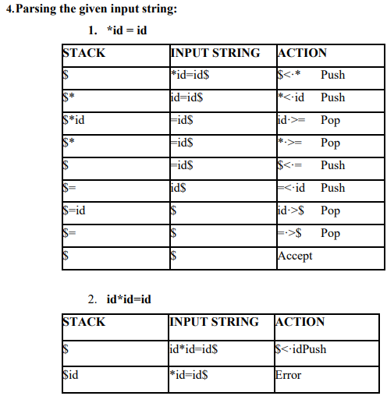
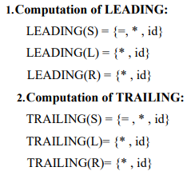
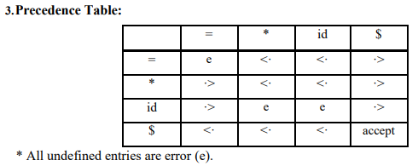
Compiler Design- Unit-3

Slide 42
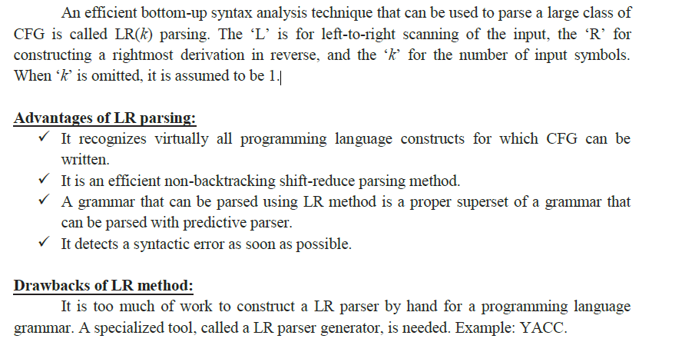
Introduction to LR Parsing

Slide 43
Why LR Parsers?
LR parsing is attractive for a variety of reasons:
LR parsers can be constructed to recognize all programming language constructs.
The LR-parsing method is the most general non backtracking shift-reduce parsing method it can be implemented efficiently.
An LR parser can detect a syntactic error as soon as it is possible to do so on a left-to-right scan of the input.
The class of grammars that can be parsed using LR methods is a proper superset of the class of grammars that can be parsed with predictive or LL methods. LR grammars can describe more languages than LL grammars.
The principal drawback of the LR method is that it is too much work to construct an LR parser for a typical programming-language grammar.

Slide 44
LR Parsers
The most powerful shift-reduce parsing (yet efficient) is:
LR(k) parsing.
left to right right-most k lookhead
scanning derivation (k is omitted 🡺 it is 1)
LR parsing is attractive because:
LR parsing is most general non-backtracking shift-reduce parsing, yet it is still efficient.
The class of grammars that can be parsed using LR methods is a proper superset of the class of grammars that can be parsed with predictive parsers. LL(1)-Grammars ⊂ LR(1)-Grammars
An LR-parser can detect a syntactic error as soon as it is possible to do so a left-to-right scan of the input.
Compiler Design- Unit-3

Slide 45
LR Parsers
LR-Parsers
covers wide range of grammars.
SLR – simple LR parser
LR – most general LR parser
LALR – intermediate LR parser (look-head LR parser)
SLR, LR and LALR work same (they used the same algorithm), only their parsing tables are different.
Compiler Design- Unit-3

Slide 46
LR Parsing Algorithm
input
a₁ | ... | a_{i} | ... | a_{n} | $
stack
S_{m}
X_{m}
S_{m-1}
X_{m-1}
.
.
S₁
X₁
S₀
LR Parsing Algorithm
output
Action Table terminals and $ s t four different a actions t e s | Goto Table non-terminal s t each item is a a state number t e s
Compiler Design- Unit-3

Slide 47
A Configuration of LR Parsing Algorithm
A configuration of a LR parsing is:
( S_{o} X₁ S₁ ... X_{m} S_{m}, a_{i} a_{i+1} ... a_{n} $ )
Stack Rest of Input
S_{m} and a_{i} decides the parser action by consulting the parsing action table. (Initial Stack contains just S_{o} )
A configuration of a LR parsing represents the right sentential form:
X₁ ... X_{m} a_{i} a_{i+1} ... a_{n} $
Compiler Design- Unit-3

Slide 48
Actions of A LR-Parser
shift s -- shifts the next input symbol and the state s onto the stack
( S_{o} X₁ S₁ ... X_{m} S_{m}, a_{i} a_{i+1} ... a_{n} $ ) 🡺 ( S_{o} X₁ S₁ ... X_{m} S_{m} a_{i} s, a_{i+1} ... a_{n} $ )
reduce A→β (or rn where n is a production number)
pop 2|β| (=r) items from the stack;
then push A and s where s=goto[s_{m-r},A]
( S_{o} X₁ S₁ ... X_{m} S_{m}, a_{i} a_{i+1} ... a_{n} $ ) 🡺 ( S_{o} X₁ S₁ ... X_{m-r} S_{m-r} A s, a_{i} ... a_{n} $ )
Output is the reducing production reduce A→β
Accept – Parsing successfully completed
Error -- Parser detected an error (an empty entry in the action table)
Compiler Design- Unit-3

Slide 49
Reduce Action
pop 2|β| (=r) items from the stack; let us assume that β = Y₁Y₂...Y_{r}
then push A and s where s=goto[s_{m-r},A]
( S_{o} X₁ S₁ ... X_{m-r} S_{m-r} Y₁ S_{m-r} ...Y_{r} S_{m}, a_{i} a_{i+1} ... a_{n} $ )
🡺 ( S_{o} X₁ S₁ ... X_{m-r} S_{m-r} A s, a_{i} ... a_{n} $ )
In fact, Y₁Y₂...Y_{r} is a handle.
X₁ ... X_{m-r} A a_{i} ... a_{n} $ ⇒ X₁ ... X_{m} Y₁...Y_{r} a_{i} a_{i+1} ... a_{n} $
Compiler Design- Unit-3

Slide 50
(SLR) Parsing Tables for Expression Grammar
Action Table
Goto Table
1) E → E+T
2) E → T
3) T → T*F
4) T → F
5) F → (E)
6) F → id
state | id | + | * | ( | ) | $ |  | E | T | F
0 | s5 |  |  | s4 |  |  |  | 1 | 2 | 3
1 |  | s6 |  |  |  | acc
2 |  | r2 | s7 |  | r2 | r2
3 |  | r4 | r4 |  | r4 | r4
4 | s5 |  |  | s4 |  |  |  | 8 | 2 | 3
5 |  | r6 | r6 |  | r6 | r6
6 | s5 |  |  | s4 |  |  |  |  | 9 | 3
7 | s5 |  |  | s4 |  |  |  |  |  | 10
8 |  | s6 |  |  | s11
9 |  | r1 | s7 |  | r1 | r1
10 |  | r3 | r3 |  | r3 | r3
11 |  | r5 | r5 |  | r5 | r5
Compiler Design- Unit-3

Slide 51
Actions of A (S)LR-Parser -- Example
stack input action output
0 id*id+id$ shift 5
0id5 *id+id$ reduce by F→id F→id
0F3 *id+id$ reduce by T→F T→F
0T2 *id+id$ shift 7
0T2*7 id+id$ shift 5
0T2*7id5 +id$ reduce by F→id F→id
0T2*7F10 +id$ reduce by T→T*F T→T*F
0T2 +id$ reduce by E→T E→T
0E1 +id$ shift 6
0E1+6 id$ shift 5
0E1+6id5 $ reduce by F→id F→id
0E1+6F3 $ reduce by T→F T→F
0E1+6T9 $ reduce by E→E+T E→E+T
0E1 $ accept
Compiler Design- Unit-3

Slide 52
Constructing SLR Parsing Tables – LR(0) Item
An LR(0) item of a grammar G is a production of G a dot at the some position of the right side.
Ex: A → aBb Possible LR(0) Items: A → .aBb
(four different possibility) A → a.Bb
A → aB.b
A → aBb.
Sets of LR(0) items will be the states of action and goto table of the SLR parser.
A collection of sets of LR(0) items (the canonical LR(0) collection) is the basis for constructing SLR parsers.
Augmented Grammar:
G’ is G with a new production rule S’→S where S’ is the new starting symbol.
Compiler Design- Unit-3

Slide 53
The Closure Operation
If I is a set of LR(0) items for a grammar G, then closure(I) is the set of LR(0) items constructed from I by the two rules:
Initially, every LR(0) item in I is added to closure(I).
If A → α.Bβ is in closure(I) and B→γ is a production rule of G; then B→.γ will be in the closure(I). We will apply this rule until no more new LR(0) items can be added to closure(I).
Compiler Design- Unit-3

Slide 54
The Closure Operation -- Example
E’ → E closure({E’ → .E}) =
E → E+T { E’ → .E kernel items
E → T E → .E+T
T → T*F E → .T
T → F T → .T*F
F → (E) T → .F
F → id F → .(E)
F → .id }
Compiler Design- Unit-3

Slide 55
Goto Operation
If I is a set of LR(0) items and X is a grammar symbol (terminal or non-terminal), then goto(I,X) is defined as follows:
If A → α.Xβ in I then every item in closure({A → αX.β}) will be in goto(I,X).
Example:
I ={ E’ → .E, E → .E+T, E → .T,
T → .T*F, T → .F,
F → .(E), F → .id }
goto(I,E) = { E’ → E., E → E.+T }
goto(I,T) = { E → T., T → T.*F }
goto(I,F) = {T → F. }
goto(I,() = { F → (.E), E → .E+T, E → .T, T → .T*F, T → .F,
F → .(E), F → .id }
goto(I,id) = { F → id. }
Compiler Design- Unit-3

Slide 56
Construction of The Canonical LR(0) Collection
To create the SLR parsing tables for a grammar G, we will create the canonical LR(0) collection of the grammar G’.
Algorithm:
C is { closure({S’→.S}) }
repeat the followings until no more set of LR(0) items can be added to C.
for each I in C and each grammar symbol X
if goto(I,X) is not empty and not in C
add goto(I,X) to C
goto function is a DFA on the sets in C.
Compiler Design- Unit-3

Slide 57
The Canonical LR(0) Collection -- Example
I₀: E’ → .E I₁: E’ → E. I₆: E → E+.T I₉: E → E+T.
E → .E+T E → E.+T T → .T*F T → T.*F
E → .T T → .F
T → .T*F I₂: E → T. F → .(E) I₁₀: T → T*F.
T → .F T → T.*F F → .id
F → .(E)
F → .id I₃: T → F. I₇: T → T*.F I₁₁: F → (E).
F → .(E)
I₄: F → (.E) F → .id
E → .E+T
E → .T I₈: F → (E.)
T → .T*F E → E.+T
T → .F
F → .(E)
F → .id
I₅: F → id.
Compiler Design- Unit-3

Slide 58
Transition Diagram (DFA) of Goto Function
I₀
E
I₁
I₂
I₃
I₄
I₅
I₆
I₇
I₈
to I₂
to I₃
to I₄
T
I₉
to I₃
to I₄
to I₅
I₁₀
to I₄
to I₅
I₁₁
to I₆
*
to I₇
F
(
T
id
F
*
F
(
id
(
E
)
id
id
T
F
+
(
Compiler Design- Unit-3

Slide 59
Constructing SLR Parsing Table (of an augumented grammar G’)
Construct the canonical collection of sets of LR(0) items for G’. C←{I₀,...,I_{n}}
Create the parsing action table as follows
If a is a terminal, A→α.aβ in I_{i} and goto(I_{i},a)=I_{j} then action[i,a] is shift j.
If A→α. is in I_{i} , then action[i,a] is reduce A→α for all a in FOLLOW(A) where A≠S’.
If S’→S. is in I_{i} , then action[i,$] is accept.
If any conflicting actions generated by these rules, the grammar is not SLR(1).
Create the parsing goto table
for all non-terminals A, if goto(I_{i},A)=I_{j} then goto[i,A]=j
All entries not defined by (2) and (3) are errors.
Initial state of the parser contains S’→.S
Compiler Design- Unit-3

Slide 60
Parsing Tables of Expression Grammar
Action Table
Goto Table
state | id | + | * | ( | ) | $ |  | E | T | F
0 | s5 |  |  | s4 |  |  |  | 1 | 2 | 3
1 |  | s6 |  |  |  | acc
2 |  | r2 | s7 |  | r2 | r2
3 |  | r4 | r4 |  | r4 | r4
4 | s5 |  |  | s4 |  |  |  | 8 | 2 | 3
5 |  | r6 | r6 |  | r6 | r6
6 | s5 |  |  | s4 |  |  |  |  | 9 | 3
7 | s5 |  |  | s4 |  |  |  |  |  | 10
8 |  | s6 |  |  | s11
9 |  | r1 | s7 |  | r1 | r1
10 |  | r3 | r3 |  | r3 | r3
11 |  | r5 | r5 |  | r5 | r5
Compiler Design- Unit-3

Slide 61
Another Example
GivenGrammar - G
S → AA
A → aA | b
Step 1:
Add Augment Production and insert '•' symbol at the first position for every production in G
S` → •S
S → •AA
A → •aA
A → •b
Step 2:
Add Augment production to the I0 State and Compute the Closure
I0 = Closure (S` → •S)

Slide 62
Contd…
Add all productions starting with "A" in modified I0 State because "•" is followed by the non-terminal. So, the I0 State becomes.
I0= S` → •S S → •AA A → •aA A → •b
I1= Go to (I0, S) = closure (S` → S•) = S` → S•
Here, the Production is reduced so close the State.
I1= S` → S•
I2= Go to (I0, A) = closure (S → A•A)
Add all productions starting with A in to I2 State because "•" is followed by the non-terminal. So, the I2 State becomes
I2 =S→A•A A → •aA A → •b

Slide 63
Contd…
I3= Go to (I0,a) = Closure (A → a•A)
Add productions starting with A in I3.
A → a•A A → •aA A → •b
I4= Go to (I0, b) = closure (A → b•) = A → b•
I5= Go to (I2, A) = Closure (S → A • A) = S → AA•
Go to (I2,a) = Closure (A → a•A) = (same as I3)
Go to (I2, b) = Closure (A → b•) = (same as I4)
Go to (I3, a) = Closure (A → a•A) = (same as I3) Go to (I3, b) = Closure (A → b•) = (same as I4)
I6= Go to (I3, A) = Closure (A → aA•) = A → aA•

Slide 64
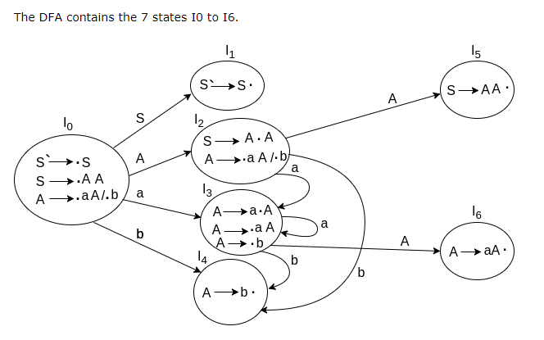
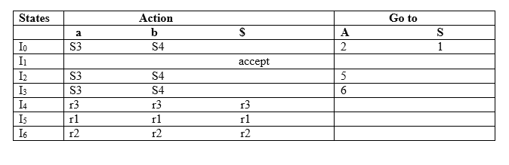
Contd…

Slide 65
LR(0) Table
If a state is going to some other state on a terminal then it correspond to a Shift move.
If a state is going to some other state on a variable then it correspond to Go to move.
If a state contain the final item in the particular row then write the Reduce move completely.

Slide 66
LR(0) Table Entry Explanation
Productions are numbered as follows:
S → AA ... (1)
A → aA ... (2)
A → b ... (3)
I0 on S is going to I1 so write it as 1.
I0 on A is going to I2 so write it as 2.
I2 on A is going to I5 so write it as 5.
I3 on A is going to I6 so write it as 6.
I0, I2and I3on a are going to I3 so write it as S3 which means that shift 3.
I0, I2 and I3 on b are going to I4 so write it as S4 which means that shift 4.
I4, I5 and I6 all states contains the final item because they contain • in the right most end. So rate the production as production number.

Slide 67
Contd…
I1 contains the final item which drives(S` → S•), so action {I1, $} = Accept.
I4 contains the final item which drives A → b• and that production corresponds to the production number 3 so write it as r3 in the entire row.
I5 contains the final item which drives S → AA• and that production corresponds to the production number 1 so write it as r1 in the entire row.
I6 contains the final item which drives A → aA• and that production corresponds to the production number 2 so write it as r2 in the entire row.

Slide 68
SLR(1) Grammar
An LR parser using SLR(1) parsing tables for a grammar G is called as the SLR(1) parser for G.
If a grammar G has an SLR(1) parsing table, it is called SLR(1) grammar (or SLR grammar in short).
Every SLR grammar is unambiguous, but every unambiguous grammar is not a SLR grammar.
Compiler Design- Unit-3

Slide 69
shift/reduce and reduce/reduce conflicts
If a state does not know whether it will make a shift operation or reduction for a terminal, we say that there is a shift/reduce conflict.
If a state does not know whether it will make a reduction operation using the production rule i or j for a terminal, we say that there is a reduce/reduce conflict.
If the SLR parsing table of a grammar G has a conflict, we say that that grammar is not SLR grammar.
Compiler Design- Unit-3

Slide 70
Conflict Example
S → L=R I₀: S’ → .S I₁: S’ → S. I₆: S → L=.R I₉: S → L=R.
S → R S → .L=R R → .L
L→ *R S → .R I₂: S → L.=R L→ .*R
L → id L → .*R R → L. L → .id
R → L L → .id
R → .L I₃: S → R.
I₄: L → *.R I₇: L → *R.
Problem R → .L
FOLLOW(R)={=,$} L→ .*R I₈: R → L.
= shift 6 L → .id
reduce by R → L
shift/reduce conflict I₅: L → id.
Compiler Design- Unit-3

Slide 71
Conflict Example2
S → AaAb I₀: S’ → .S
S → BbBa S → .AaAb
A → ε S → .BbBa
B → ε A → .
B → .
Problem
FOLLOW(A)={a,b}
FOLLOW(B)={a,b}
a reduce by A → ε b reduce by A → ε
reduce by B → ε reduce by B → ε
reduce/reduce conflict reduce/reduce conflict
Compiler Design- Unit-3

Slide 72
Constructing Canonical LR(1) Parsing Tables
In SLR method, the state i makes a reduction by A→α when the current token is a:
if the A→α. in the I_{i} and a is FOLLOW(A)
In some situations, βA cannot be followed by the terminal a in a right-sentential form when βα and the state i are on the top stack. This means that making reduction in this case is not correct.
S → AaAb S⇒AaAb⇒Aab⇒ab S⇒BbBa⇒Bba⇒ba
S → BbBa
A → ε Aab ⇒ ε ab Bba ⇒ ε ba
B → ε AaAb ⇒ Aa ε b BbBa ⇒ Bb ε a
Compiler Design- Unit-3

Slide 73
LR(1) Item
To avoid some of invalid reductions, the states need to carry more information.
Extra information is put into a state by including a terminal symbol as a second component in an item.
A LR(1) item is:
A → α.β,a where a is the look-head of the LR(1) item
(a is a terminal or end-marker.)
Compiler Design- Unit-3

Slide 74
LR(1) Item (cont.)
When β ( in the LR(1) item A → α.β,a ) is not empty, the look-head does not have any affect.
When β is empty (A → α.,a ), we do the reduction by A→α only if the next input symbol is a (not for any terminal in FOLLOW(A)).
A state will contain A → α.,a₁ where {a₁,...,a_{n}} ⊆ FOLLOW(A)
...
A → α.,a_{n}
Compiler Design- Unit-3

Slide 75
Canonical Collection of Sets of LR(1) Items
The construction of the canonical collection of the sets of LR(1) items are similar to the construction of the canonical collection of the sets of LR(0) items, except that closure and goto operations work a little bit different.
closure(I) is: ( where I is a set of LR(1) items)
every LR(1) item in I is in closure(I)
if A→α.Bβ,a in closure(I) and B→γ is a production rule of G; then B→.γ,b will be in the closure(I) for each terminal b in FIRST(βa) .
Compiler Design- Unit-3

Slide 76
goto operation
If I is a set of LR(1) items and X is a grammar symbol (terminal or non-terminal), then goto(I,X) is defined as follows:
If A → α.Xβ,a in I then every item in closure({A → αX.β,a}) will be in goto(I,X).
Compiler Design- Unit-3

Slide 77
Construction of The Canonical LR(1) Collection
Algorithm:
C is { closure({S’→.S,$}) }
repeat the followings until no more set of LR(1) items can be added to C.
for each I in C and each grammar symbol X
if goto(I,X) is not empty and not in C
add goto(I,X) to C
goto function is a DFA on the sets in C.
Compiler Design- Unit-3

Slide 78
A Short Notation for The Sets of LR(1) Items
A set of LR(1) items containing the following items
A → α.β,a₁
...
A → α.β,a_{n}
can be written as
A → α.β,a₁/a₂/.../a_{n}
Compiler Design- Unit-3

Slide 79
Canonical LR(1) Collection -- Example
S → AaAb I₀: S’ → .S ,$ I₁: S’ → S. ,$
S → BbBa S → .AaAb ,$
A → ε S → .BbBa ,$ I₂: S → A.aAb ,$
B → ε A → . ,a
B → . ,b I₃: S → B.bBa ,$
I₄: S → Aa.Ab ,$ I₆: S → AaA.b ,$ I₈: S → AaAb. ,$
A → . ,b
I₅: S → Bb.Ba ,$ I₇: S → BbB.a ,$ I₉: S → BbBa. ,$
B → . ,a
S
A
a
to I₄
B
b
to I₅
A
a
B
b
Compiler Design- Unit-3

Slide 80
Canonical LR(1) Collection – Example2
S’ → S
1) S → L=R
2) S → R
3) L→ *R
4) L → id
5) R → L
I₀:S’ → .S,$
S → .L=R,$
S → .R,$
L → .*R,$/=
L → .id,$/=
R → .L,$
I₁:S’ → S.,$
I₄:L → *.R,$/=
R → .L,$/=
L→ .*R,$/=
L → .id,$/=
R
to I₇
S
*
L
I₂:S → L.=R,$
R → L.,$
to I₆
to I₈
L
*
to I₄
id
R
to I₅
I₃:S → R.,$
id
I₅:L → id.,$/=
I₉:S → L=R.,$
I₁₀:R → L.,$
I₁₁:L → *.R,$
R → .L,$
L→ .*R,$
L → .id,$
I₁₂:L → id.,$
R
I₁₃:L → *R.,$
I₆:S → L=.R,$
R → .L,$
L → .*R,$
L → .id,$
to I₉
L
to I₁₀
*
I₄ and I₁₁
I₅ and I₁₂
I₇ and I₁₃
I₈ and I₁₀
to I₁₁
R
to I₁₃
id
L
to I₁₂
to I₁₀
I₇:L → *R.,$/=
*
to I₁₁
id
I₈: R → L.,$/=
to I₁₂
Compiler Design- Unit-3

Slide 81
Construction of LR(1) Parsing Tables
Construct the canonical collection of sets of LR(1) items for G’. C←{I₀,...,I_{n}}
Create the parsing action table as follows
If a is a terminal, A→α.aβ,b in I_{i} and goto(I_{i},a)=I_{j} then action[i,a] is shift j.
If A→α.,a is in I_{i} , then action[i,a] is reduce A→α where A≠S’.
If S’→S.,$ is in I_{i} , then action[i,$] is accept.
If any conflicting actions generated by these rules, the grammar is not LR(1).
Create the parsing goto table
for all non-terminals A, if goto(I_{i},A)=I_{j} then goto[i,A]=j
All entries not defined by (2) and (3) are errors.
Initial state of the parser contains S’→.S,$
Compiler Design- Unit-3

Slide 82
LR(1) Parsing Tables – (for Example2)
 | id | * | = | $ | S | L | R
0 | s5 | s4 |  |  | 1 | 2 | 3
1 |  |  |  | acc
2 |  |  | s6 | r5
3 |  |  |  | r2
4 | s5 | s4 |  |  |  | 8 | 7
5 |  |  | r4 | r4
6 | s12 | s11 |  |  |  | 10 | 9
7 |  |  | r3 | r3
8 |  |  | r5 | r5
9 |  |  |  | r1
10 |  |  |  | r5
11 | s12 | s11 |  |  |  | 10 | 13
12 |  |  |  | r4
13 |  |  |  | r3
no shift/reduce or
no reduce/reduce conflict
⇓
so, it is a LR(1) grammar
Compiler Design- Unit-3

Slide 83
LALR Parsing Tables
LALR stands for LookAhead LR.
LALR parsers are often used in practice because LALR parsing tables are smaller than LR(1) parsing tables.
The number of states in SLR and LALR parsing tables for a grammar G are equal.
But LALR parsers recognize more grammars than SLR parsers.
yacc creates a LALR parser for the given grammar.
A state of LALR parser will be again a set of LR(1) items.
Compiler Design- Unit-3

Slide 84
Creating LALR Parsing Tables
Canonical LR(1) Parser 🡺 LALR Parser
shrink # of states
This shrink process may introduce a reduce/reduce conflict in the resulting LALR parser (so the grammar is NOT LALR)
But, this shrik process does not produce a shift/reduce conflict.
Compiler Design- Unit-3

Slide 85
The Core of A Set of LR(1) Items
The core of a set of LR(1) items is the set of its first component.
Ex: S → L.=R,$ 🡺 S → L.=R Core
R → L.,$ R → L.
We will find the states (sets of LR(1) items) in a canonical LR(1) parser with same cores. Then we will merge them as a single state.
I₁:L → id.,= A new state: I₁₂: L → id.,=
🡺 L → id.,$
I₂:L → id.,$ have same core, merge them
We will do this for all states of a canonical LR(1) parser to get the states of the LALR parser.
In fact, the number of the states of the LALR parser for a grammar will be equal to the number of states of the SLR parser for that grammar.
Compiler Design- Unit-3

Slide 86
Creation of LALR Parsing Tables
Create the canonical LR(1) collection of the sets of LR(1) items for the given grammar.
Find each core; find all sets having that same core; replace those sets having same cores with a single set which is their union.
C={I₀,...,I_{n}} 🡺 C’={J₁,...,J_{m}} where m ≤ n
Create the parsing tables (action and goto tables) same as the construction of the parsing tables of LR(1) parser.
Note that: If J=I₁ ∪ ... ∪ I_{k} since I₁,...,I_{k} have same cores
🡺 cores of goto(I₁,X),...,goto(I₂,X) must be same.
So, goto(J,X)=K where K is the union of all sets of items having same cores as goto(I₁,X).
If no conflict is introduced, the grammar is LALR(1) grammar. (We may only introduce reduce/reduce conflicts; we cannot introduce a shift/reduce conflict)
Compiler Design- Unit-3

Slide 87
Shift/Reduce Conflict
We say that we cannot introduce a shift/reduce conflict during the shrink process for the creation of the states of a LALR parser.
Assume that we can introduce a shift/reduce conflict. In this case, a state of LALR parser must have:
A → α.,a and B → β.aγ,b
This means that a state of the canonical LR(1) parser must have:
A → α.,a and B → β.aγ,c
But, this state has also a shift/reduce conflict. i.e. The original canonical LR(1) parser has a conflict.
(Reason for this, the shift operation does not depend on lookaheads)
Compiler Design- Unit-3

Slide 88
Reduce/Reduce Conflict
But, we may introduce a reduce/reduce conflict during the shrink process for the creation of the states of a LALR parser.
I₁ : A → α.,a I₂: A → α.,b
B → β.,b B → β.,c
⇓
I₁₂: A → α.,a/b 🡺 reduce/reduce conflict
B → β.,b/c
Compiler Design- Unit-3

Slide 89
Canonical LALR(1) Collection – Example2
S’ → S
1) S → L=R
2) S → R
3) L→ *R
4) L → id
5) R → L
I₀:S’ → .S,$
S → .L=R,$
S → .R,$
L → .*R,$/=
L → .id,$/=
R → .L,$
I₁:S’ → S.,$
I₄₁₁:L → *.R,$/=
R → .L,$/=
L→ .*R,$/=
L → .id,$/=
R
to I₇₁₃
S
*
L
I₂:S → L.=R,$
R → L.,$
to I₆
to I₈₁₀
L
*
to I₄₁₁
id
R
to I₅₁₂
I₃:S → R.,$
id
I₅₁₂:L → id.,$/=
R
I₉:S → L=R.,$
I₆:S → L=.R,$
R → .L,$
L → .*R,$
L → .id,$
to I₉
Same Cores
I₄ and I₁₁
I₅ and I₁₂
I₇ and I₁₃
I₈ and I₁₀
L
to I₈₁₀
*
to I₄₁₁
id
to I₅₁₂
I₇₁₃:L → *R.,$/=
I₈₁₀: R → L.,$/=
Compiler Design- Unit-3

Slide 90
LALR(1) Parsing Tables – (for Example2)
 | id | * | = | $ | S | L | R
0 | s5 | s4 |  |  | 1 | 2 | 3
1 |  |  |  | acc
2 |  |  | s6 | r5
3 |  |  |  | r2
4 | s5 | s4 |  |  |  | 8 | 7
5 |  |  | r4 | r4
6 | s12 | s11 |  |  |  | 10 | 9
7 |  |  | r3 | r3
8 |  |  | r5 | r5
9 |  |  |  | r1
no shift/reduce or
no reduce/reduce conflict
⇓
so, it is a LALR(1) grammar
Compiler Design- Unit-3

Slide 91
Using Ambiguous Grammars
All grammars used in the construction of LR-parsing tables must be un-ambiguous.
Can we create LR-parsing tables for ambiguous grammars ?
Yes, but they will have conflicts.
We can resolve these conflicts in favor of one of them to disambiguate the grammar.
At the end, we will have again an unambiguous grammar.
Why we want to use an ambiguous grammar?
Some of the ambiguous grammars are much natural, and a corresponding unambiguous grammar can be very complex.
Usage of an ambiguous grammar may eliminate unnecessary reductions.
Ex.
E → E+T | T
E → E+E | E*E | (E) | id 🡺 T → T*F | F
F → (E) | id
Compiler Design- Unit-3

Slide 92
Sets of LR(0) Items for Ambiguous Grammar
I₀: E’ → .E
E → .E+E
E → .E*E
E → .(E)
E → .id
E
I₁: E’ → E.
E → E .+E
E → E .*E
+
I₄: E → E +.E
E → .E+E
E → .E*E
E → .(E)
E → .id
E
+
I₇: E → E+E.
E → E.+E
E → E.*E
I₄
(
*
I₅
I₂
*
id
I₃
(
(
I₅: E → E *.E
E → .E+E
E → .E*E
E → .(E)
E → .id
E
+
(
I₈: E → E*E.
E → E.+E
E → E.*E
I₄
I₂: E → (.E)
E → .E+E
E → .E*E
E → .(E)
E → .id
I₂
*
id
I₅
I₃
E
id
id
)
I₆: E → (E.)
E → E.+E
E → E.*E
I₉: E → (E).
+
I₃: E → id.
*
I₄
I₅
Compiler Design- Unit-3

Slide 93
SLR-Parsing Tables for Ambiguous Grammar
FOLLOW(E) = { $,+,*,) }
State I₇ has shift/reduce conflicts for symbols + and *.
I₀
E
I₁
+
I₄
E
I₇
when current token is +
shift 🡺 + is right-associative
reduce 🡺 + is left-associative
when current token is *
shift 🡺 * has higher precedence than +
reduce 🡺 + has higher precedence than *
Compiler Design- Unit-3

Slide 94
SLR-Parsing Tables for Ambiguous Grammar
FOLLOW(E) = { $,+,*,) }
State I₈ has shift/reduce conflicts for symbols + and *.
I₀
E
I₁
*
I₅
E
I₇
when current token is *
shift 🡺 * is right-associative
reduce 🡺 * is left-associative
when current token is +
shift 🡺 + has higher precedence than *
reduce 🡺 * has higher precedence than +
Compiler Design- Unit-3

Slide 95
SLR-Parsing Tables for Ambiguous Grammar
Action
Goto
 | id | + | * | ( | ) | $ |  | E
0 | s3 |  |  | s2 |  |  |  | 1
1 |  | s4 | s5 |  |  | acc
2 | s3 |  |  | s2 |  |  |  | 6
3 |  | r4 | r4 |  | r4 | r4
4 | s3 |  |  | s2 |  |  |  | 7
5 | s3 |  |  | s2 |  |  |  | 8
6 |  | s4 | s5 |  | s9
7 |  | r1 | s5 |  | r1 | r1
8 |  | r2 | r2 |  | r2 | r2
9 |  | r3 | r3 |  | r3 | r3
Compiler Design- Unit-3

